Slide 1
Multi-omics Boot Camp
Analysis of Omics Data for Research Studies
Introduction

Slide 2
Goals
Provide a context for the workshop and of “Multi-omics in Observational Studies”
Provide a background on common analysis/statistical themes and methods used throughout the workshop.
Data – HELIX Multi-omics data
Regression: (parameters of interest, testing, confounding, glms)
Multiple variable regression techniques and feature selection.
Approaches to multi-omics analysis.
Integration of multi-omics data.
Integration of association analyses.

Slide 3
Observational Studies
Does exposure to organochlorines (a chemical compound in pesticides and insulators) influence obesity in children?
E
Y
PCBs, DDT
BMI

Slide 4
Genomewide Association Studies
Does variation in germline genetics influence obesity in children?
G
Y
SNP, PRS
BMI

Slide 5
Interaction
Does exposure to organochlorines interact with measures of inflammation to influence obesity in children?
IL1-beta, IL6, TNF-alpha
M
Y
BMI
E
PCBs, DDT

Slide 6
GWIS
Does exposure to organochlorines interact with single nucleotide polymorphisms (SNPs) to influence obesity in children?
GWAS or Genes in Inflammation Pathways
G
Y
BMI
PCBs, DDT
E

Slide 7
Instrumental Variable Analysis (MR and TWAS)
Do genetically imputed levels of inflammatory markers influence obesity in children?
M
IL1-beta, IL6, TNF-alpha
SNPs within Genes in Inflammation Pathways
G
Y
BMI

Slide 8
Mediation
Does exposure to organochlorines impact levels of inflammatory markers that then influence obesity in children?
IL1-beta, IL6, TNF-alpha
E
M
Y
PCBs, DDT
BMI

Slide 9
Latent Variable Models
Does exposure to organochlorines influence obesity in children and can that risk be characterized by patterns in inflammatory markers?
IL1-beta, IL6, TNF-alpha
M
GWAS or Genes in Inflammation Pathways
Inflammation Pathways
E/G
Y
PCBs, DDT
L
BMI

Slide 10




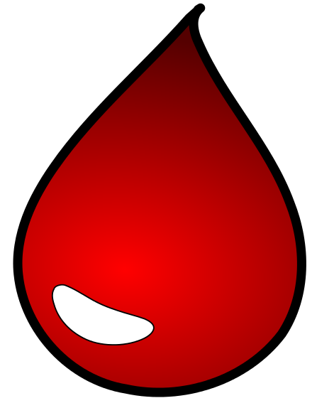
The HELIX Project
Participating Cohorts
time
N= 805
Pregnancy
(exposures)
6-10 years
?
Waist circumference
Fish intake
Blood pressure
Mercury levels
Blood lipids, insulin, inflammatory markers
10

Slide 11
HELIX Exposome Challenge Data
https://www.isglobal.org/-/exposome-data-analysis-challenge

Slide 12
Multi-view data for prospective cohort
Human Early Life Exposome (HELIX) Study
Air pollution
Noise
Indoor air quality
Organochlorines
PFAS
Metals
Smoking
Diet
Physical activity
Genetics
Proteomics
Methylation
Metabolomics
Phenotype: e.g. Body mass index
Notes:
If we take study design into account, in the context of prospective cohort study, the multi-view data can be categorized into three main types: exposure, health outcome, and omics type data. My work will focus on the integrative analysis of multi-view data under prospective study design.

Slide 13
Multi-view data for prospective cohort
Human Early Life Exposome (HELIX) Study
Air pollution
Noise
Indoor air quality
Organochlorines
PFAS
Metals
Smoking
Diet
Physical activity
Genetics
Geographic Information System (GIS)
Proteomics
Methylation
Metabolomics
Plasma (Luminex kits)
Buffy coat (Illumina)
Bio-samples
Urine and Serum (Spectroscopy)
Questionnaires
Phenotype: e.g. Body mass index
Stadiometer and digital weight scale
Buffy coat (Illumina)
Notes:
If we take study design into account, in the context of prospective cohort study, the multi-view data can be categorized into three main types: exposure, health outcome, and omics type data. My work will focus on the integrative analysis of multi-view data under prospective study design.

Slide 14
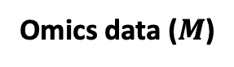
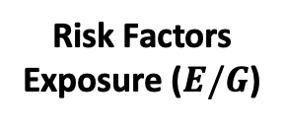
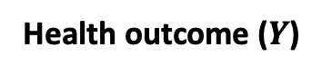
Multi-view data for prospective cohort
Human Early Life Exposome (HELIX) Study
Air pollution
Noise
Indoor air quality
Organochlorines
PFAS
Metals
Smoking
Diet
Physical activity
Genetics
Proteomics
Methylation
Metabolomics
Risk Factors
Exposure ($E/G$)
Omics data ($M$)
Phenotype: e.g. Body mass index
Health outcome ($Y$)
Notes:
If we take study design into account, in the context of prospective cohort study, the multi-view data can be categorized into three main types: exposure, health outcome, and omics type data. My work will focus on the integrative analysis of multi-view data under prospective study design.

Slide 15
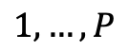
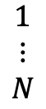
Omics Data
$$1,…,P$$
Single omic layer measured on a set of individuals.
Data generation and processing, variant calling from sequence reads, reading spectroscopy.
Quality control: standardization, normalization, and batch correction.
$$\begin{matrix}1 \\ ⋮ \\ N\end{matrix}$$

Slide 16
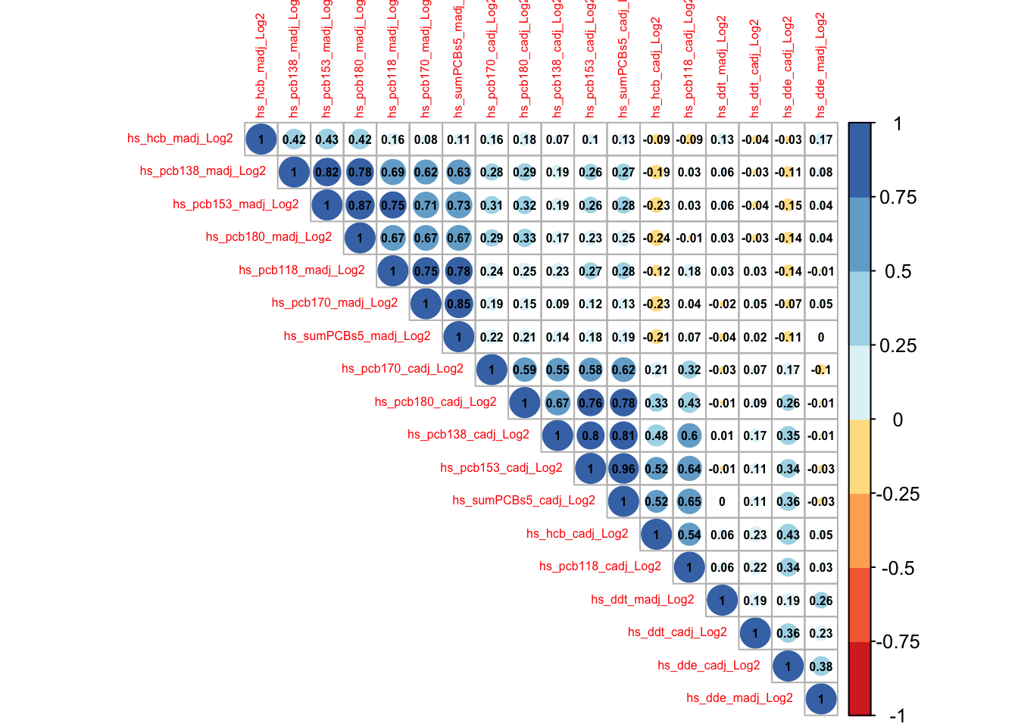
Omics Data
$$1,…,P$$
Single omic layer measured on a set of individuals.
Data generation and processing, variant calling from sequence reads, reading spectroscopy.
Quality control: standardization, normalization, and batch correction.
Descriptive statistics: correlation, visualization.
$$\begin{matrix}1 \\ ⋮ \\ N\end{matrix}$$

Slide 17
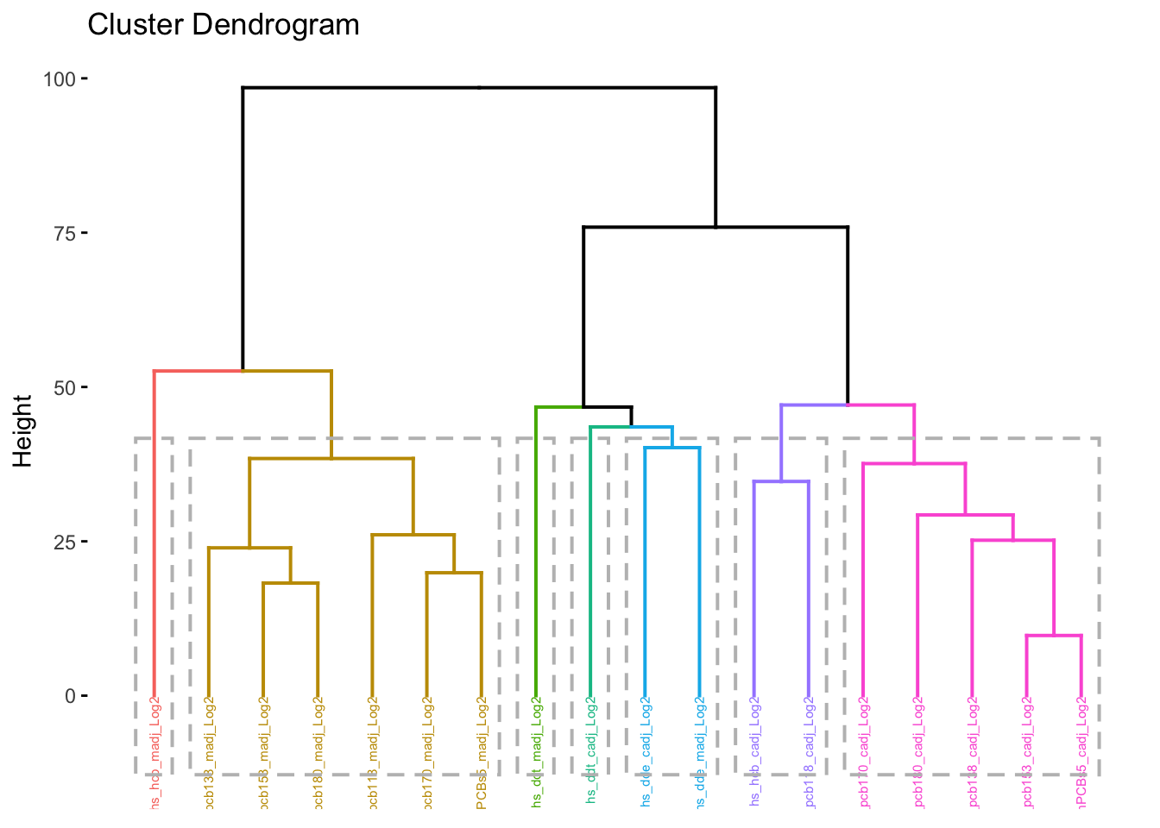
Omics Data
$$1,…,P$$
Single omic layer measured on a set of individuals.
High Dimensional Data Reduction via Feature Extraction:
Aims to transform the input features into a reduced set of variables that are a linear/non-linear combination of the original features.
Examples:
Hierarchical clustering, k-means, model-based clustering.
Principal components (PCA), kernel PCA, Bayesian PCA, Correspondence analysis (CA).
Combine with feature selection: Sparse PCA (sPCA), Sparse Canonical Correlation Analysis (CCA), Sparse Non-Negative Matrix Factorization (Sparse NMF), Sparse CA.
$$\begin{matrix}1 \\ ⋮ \\ N\end{matrix}$$

Slide 18
Two-(or more) Layers Omic Data
Exposome
Proteome

Slide 19
Early Integration
Exposome
Proteome
L

Slide 20
Late Integration
Exposome
Proteome
L_{E}
Compare
L_{P}

Slide 21
Omic Integration
Rappoport and Shamir. Nucleic Acids Research 2018

Slide 22
Association Analysis with Omics
Single omic layer measured on a set of individuals with association to an outcome.
One low dimensional and one high dimensional.
Example 1: the association of single nucleotide polymorphisms (SNPs) on a phenotype.
Y

Slide 23
Association Analysis with Omics
Single omic layer measured on a set of individuals with association to a risk factor.
One low dimensional and one high dimensional.
Example 2: the impact of treatment on gene expression levels.
Tx

Slide 24
What about dimension reduction or clustering?
Leveraging biology before analysis (i.e. use annotation):
Select genes (or SNPs in/near genes) in select pathways.
Select metabolites (from targeted vs. untargeted) in select pathways.
Y

Slide 25
Interpreting Pairwise Results
Leveraging biology after analysis:
Select genes (or SNPs in/near genes) in select pathways.
Select metabolites (from targeted or untargeted) in select pathways.
Pathway Analysis (are genes in a pathway overrepresented in noteworthy results?)
Y

Slide 26
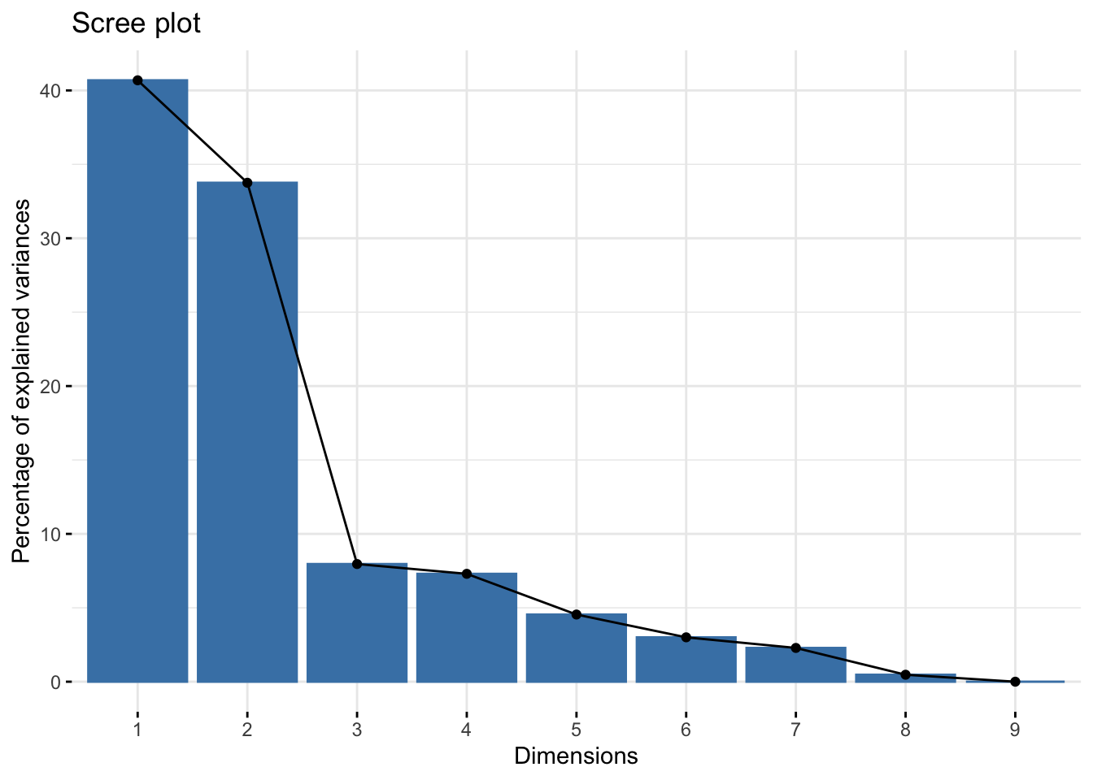
What about dimension reduction or clustering?
Data driven clustering before association analysis:
Y
L

Slide 27
Association
E
Y
PCBs, DDT
BMI

Slide 28
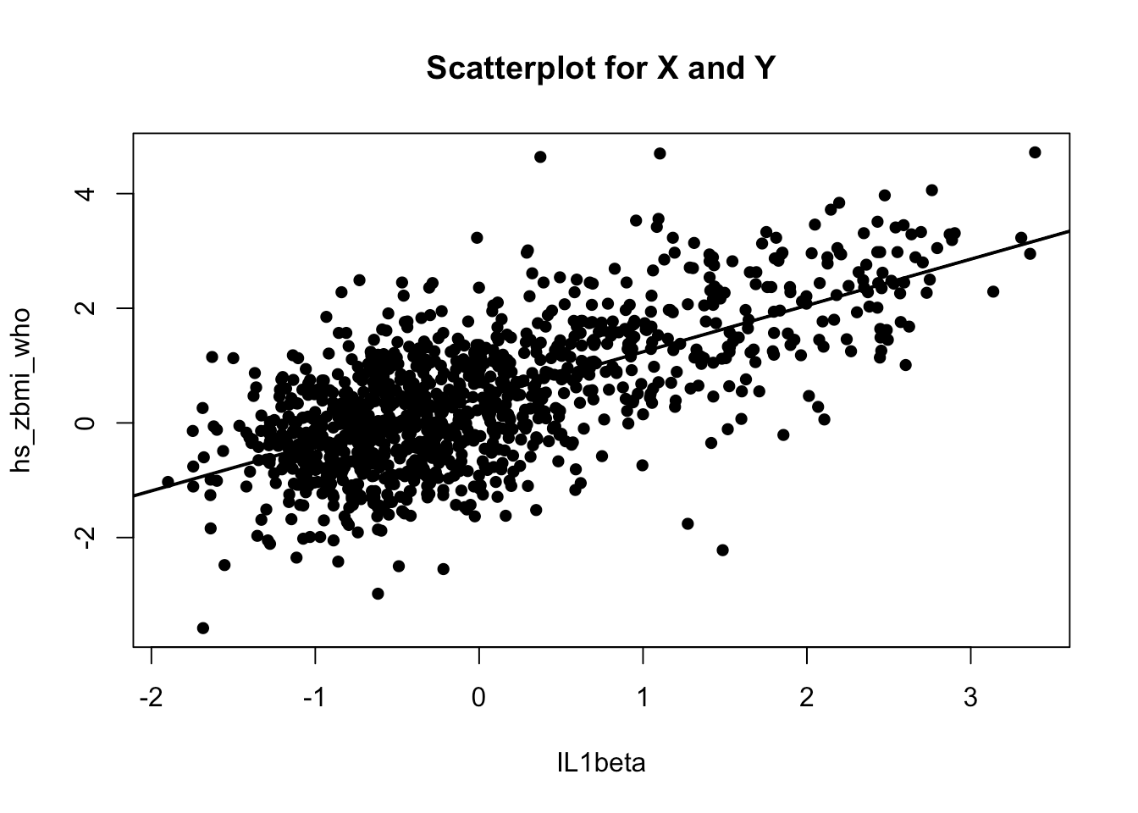
Linear Regression
X
Y

Slide 29
Linear Regression

Slide 30
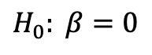
Testing the Slope
Test the null hypotheses:
Calculate the test statistic:
Choose a Type I error (α-level)
Determine which values of the test statistic will lead you to reject the null hypothesis.
$$H_{0}: β=0$$

Slide 31
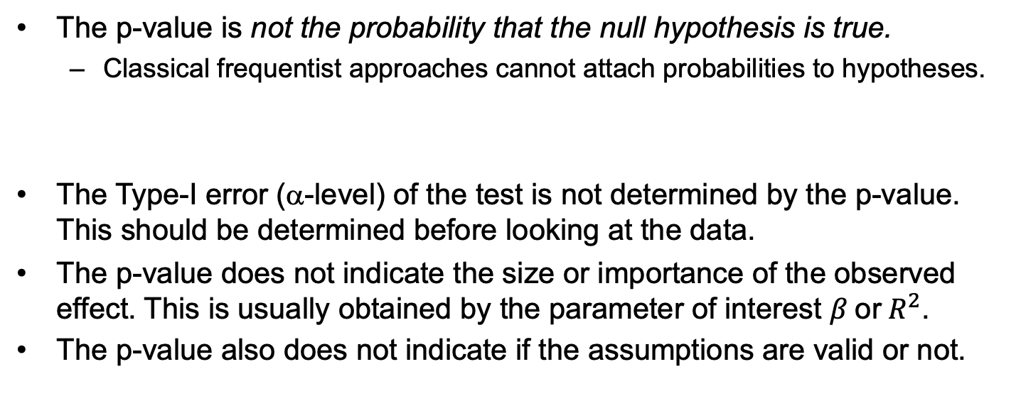
The p-value
The p-value is not the probability that the null hypothesis is true.
Classical frequentist approaches cannot attach probabilities to hypotheses.
The Type-I error (α-level) of the test is not determined by the p-value. This should be determined before looking at the data.
The p-value does not indicate the size or importance of the observed effect. This is usually obtained by the parameter of interest $β \text{or} R^{2}$.
The p-value also does not indicate if the assumptions are valid or not.

Slide 32
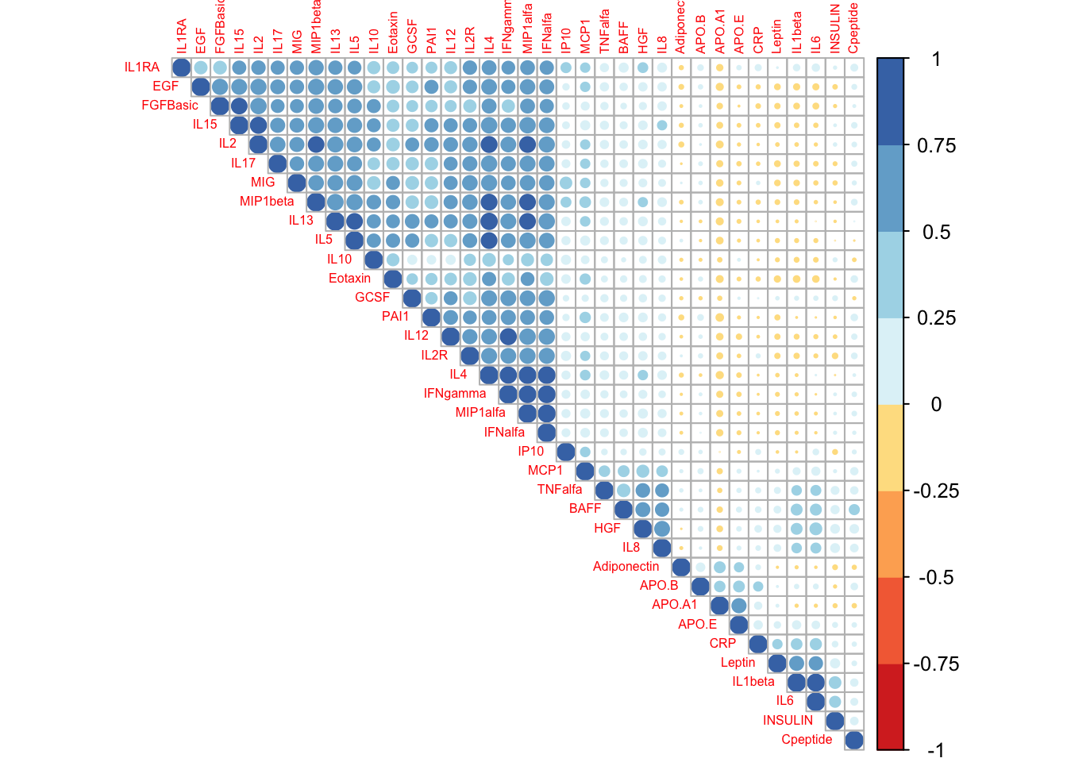
Regression Across Many Correlated Variables

Slide 33
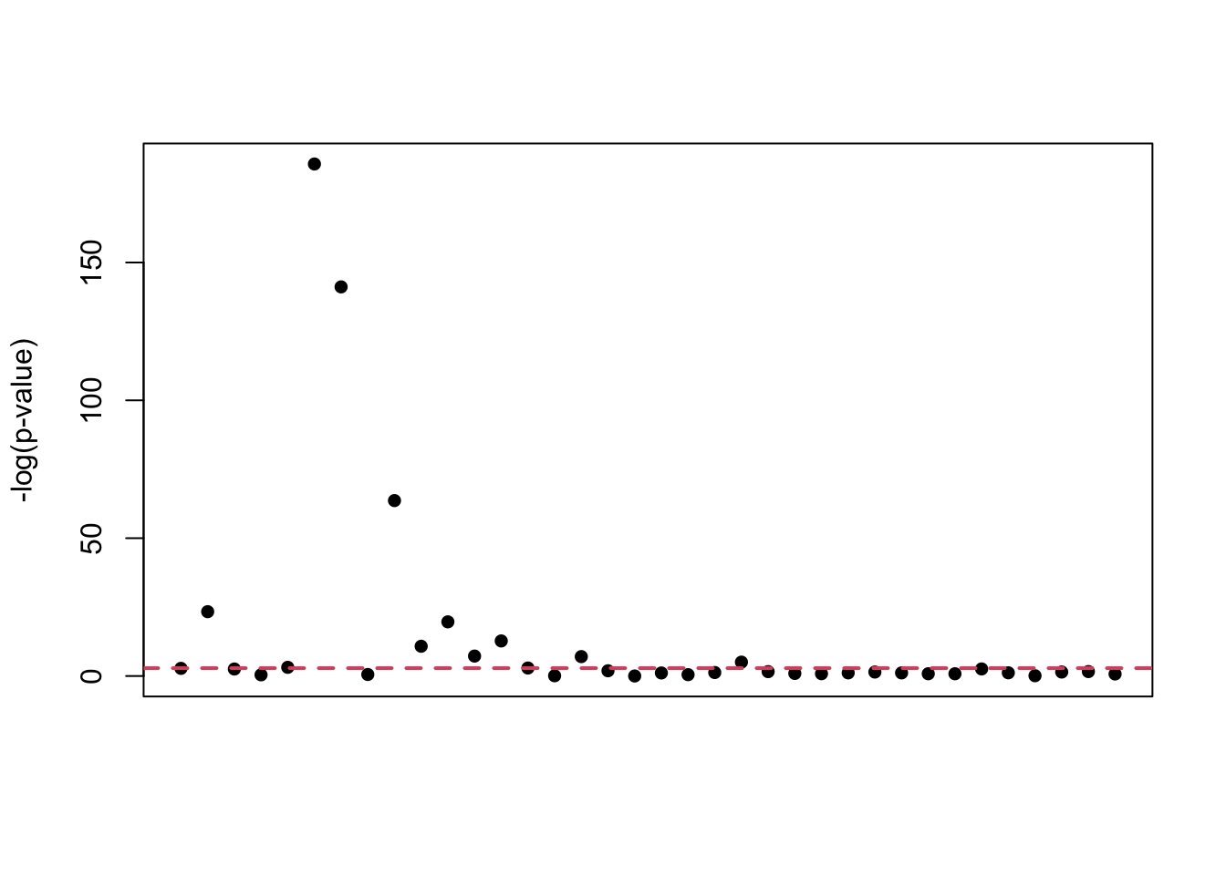
Regression Across Many Correlated Variables
Univariate model

Slide 34
Multiple Testing
Observed P-value Distribution
Oracle P-value Distribution

Slide 35

Multiple Testing
Bonferroni correction
p < α/N (ensure that the overall probability of declaring significance is maintained).
Conservative with non-independent tests.
$$α=0.05$$

Slide 36
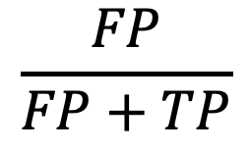
Multiple Testing
Bonferroni correction
p < α/N (ensure that the overall probability of declaring significance is maintained).
Conservative with non-independent tests.
FDR:
Multiple types of implementation.
Estimate the expected proportion of false positives to the number of total declared significant.
$$\frac{FP}{FP+TP}$$

Slide 37
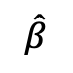
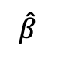
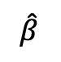
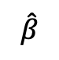
Bayesian False Discovery Probability
Calculates the probability of a hypothesis in a Bayesian framework.
We end up with the probability of the data averaging over both the null and alternative hypotheses.
Then we can calculate the probability of the null hypothesis given the data:
$$\hat{β}$$
$$\hat{β}$$
$$\hat{β}$$
$$\hat{β}$$
Wakefield 2007

Slide 38
Bayesian False Discovery Probability
The advantage is that the alternative hypothesis is a function of the effect estimate:
And the ratio of both hypotheses is the Bayes factor:
Wakefield 2007

Slide 39
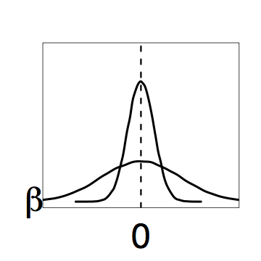
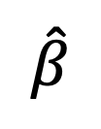
Mixture of Hypotheses
Normal densities of the effect estimate under the null and alternative hypotheses.
$$\hat{β}$$

Slide 40
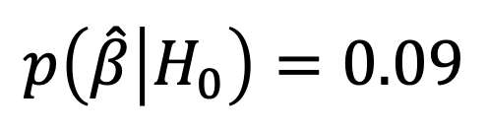
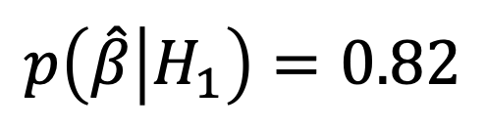
Mixture of Hypotheses
Normal densities of the effect estimate under the null and alternative hypotheses.
$$p\left(\hat{β} | H_{1}\right)=0.82$$
$$\hat{β}$$
$$p\left(\hat{β} | H_{0}\right)=0.09$$

Slide 41
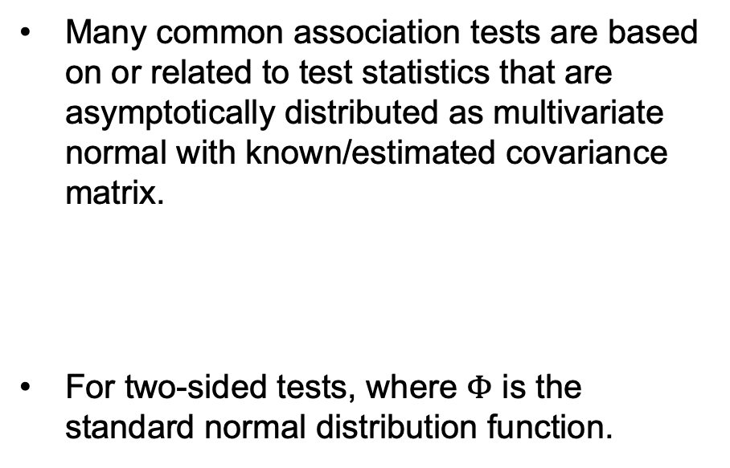
P Value Adjustment for Correlated Test
Many common association tests are based on or related to test statistics that are asymptotically distributed as multivariate normal with known/estimated covariance matrix.
For two-sided tests, where $Φ$ is the standard normal distribution function.
Shaded area represents the space (extended to infinity) over which the probability P_Act is measured
Conneely and Boehnke AJHG 2007

Slide 42
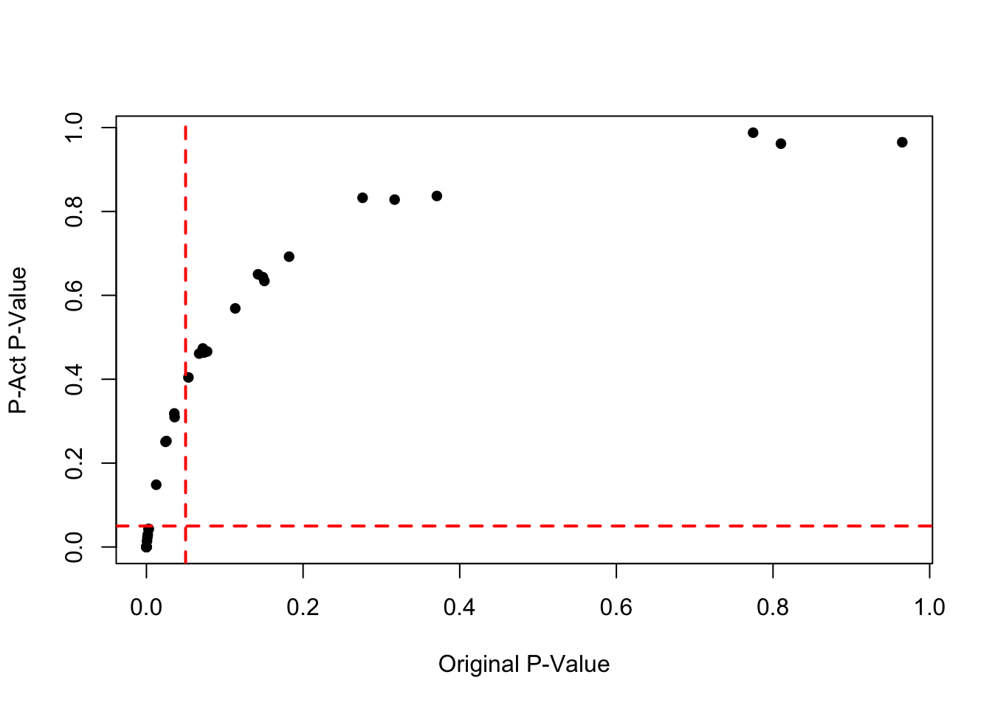
P Value Adjustment for Correlated Test
Many common association tests are based on or related to test statistics that are asymptotically distributed as multivariate normal with known/estimated covariance matrix.
For two-sided tests, where $Φ$ is the standard normal distribution function.
Conneely and Boehnke AJHG 2007

Slide 43
Multivariable Regression
When the number of predictors (P) approaches the number of individuals (N), or is greater than N, estimation of model parameters can be unstable.
Selection of features:
Selection using statistical significance of each feature (e.g. forward selection with p-values)
A priori selection of features

Slide 44
Multivariable Regression
When the number of predictors (P) approaches the number of individuals (N), or is greater than N, estimation of model parameters can be unstable.
Selection of features:
Selection using statistical significance of each feature (e.g. forward selection with p-values)
A priori selection of features
Stabilize or penalize estimates and fit the full model (e.g. hierarchical modeling, ridge regression)

Slide 45
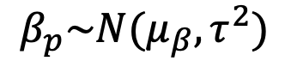
Hierarchical Regression
$$β_{p}\sim N(μ_{β},τ^{2})$$

Slide 46
Hierarchical Regression
$$β_{p}\sim N(μ_{β},τ^{2})$$
Posterior estimates are a weighted average:

Slide 47
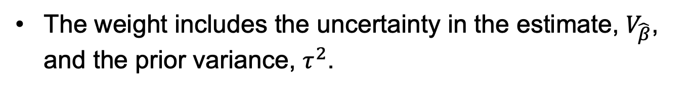
Hierarchical Regression
$$β_{p}\sim N(μ_{β},τ^{2})$$
Posterior estimates are a weighted average:
The weight includes the uncertainty in the estimate, $V_{\hat{β}}$, and the prior variance, $τ^{2}$.

Slide 48
Hierarchical Regression

Slide 49
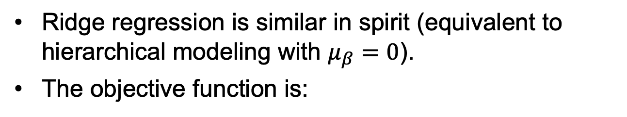
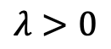
Ridge Regression
Ridge regression is similar in spirit (equivalent to hierarchical modeling with $μ_{β}=0$).
The objective function is:
$$λ>0$$

Slide 50
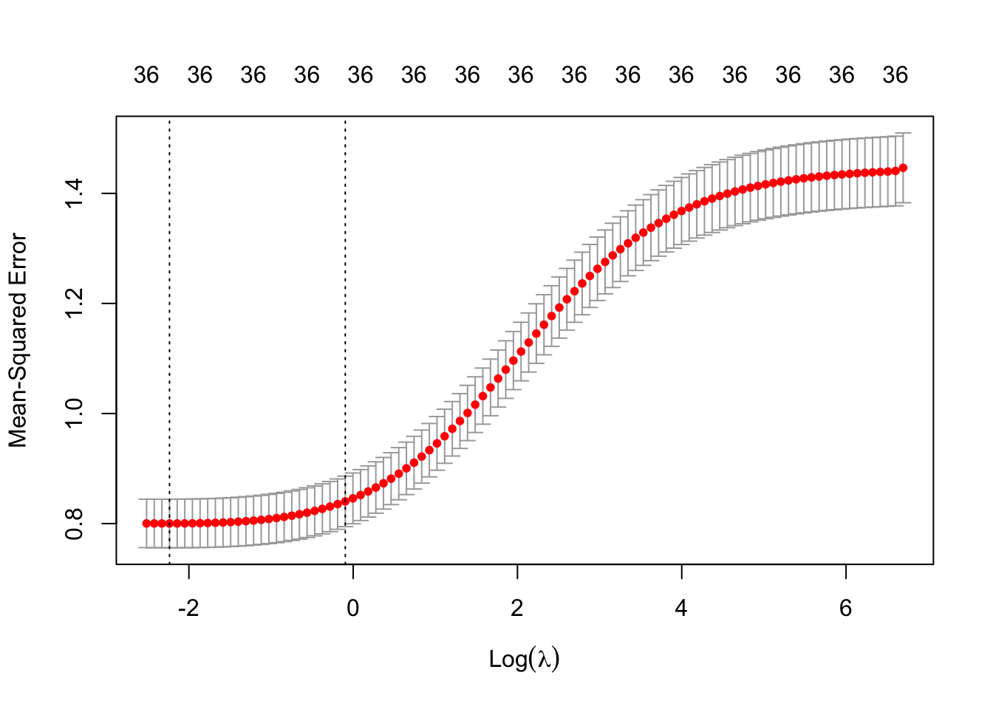
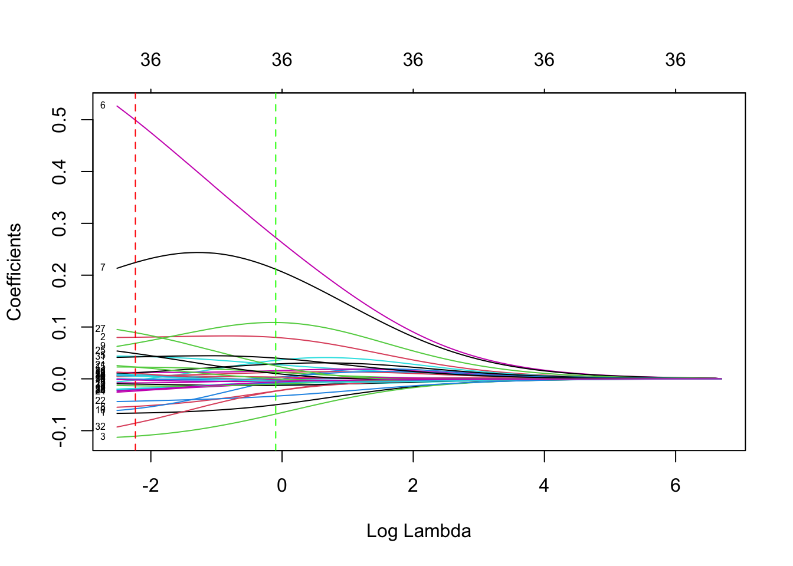
Ridge Regression – Selection of λ

Slide 51
Multivariable Regression
When the number of predictors (P) approaches the number of individuals (N), or is greater than N, estimation of model parameters can be unstable.
Selection of features:
Selection using statistical significance of each feature (e.g. forward selection with p-values)
A priori selection of features
Stabilize or penalize estimates and fit the full model (e.g. hierarchical modeling, ridge regression)
Combined approaches (e.g. Lasso, Bayesian stochastic selection)

Slide 52
Lasso Regression
Lasso regression places a Laplace prior (i.e. double exponential) on the effect estimates:
The corresponding objective function is:

Slide 53
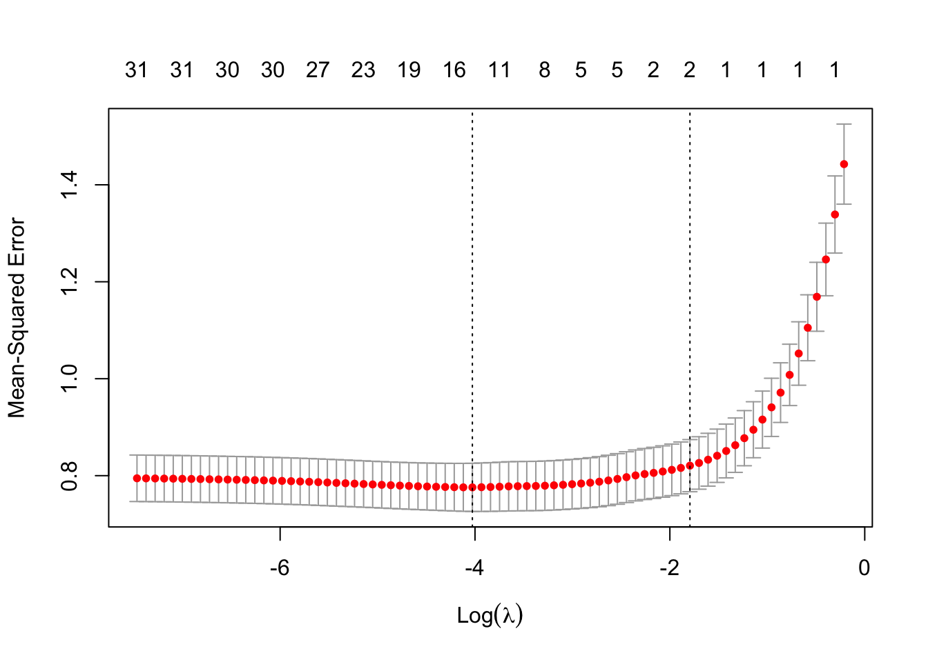
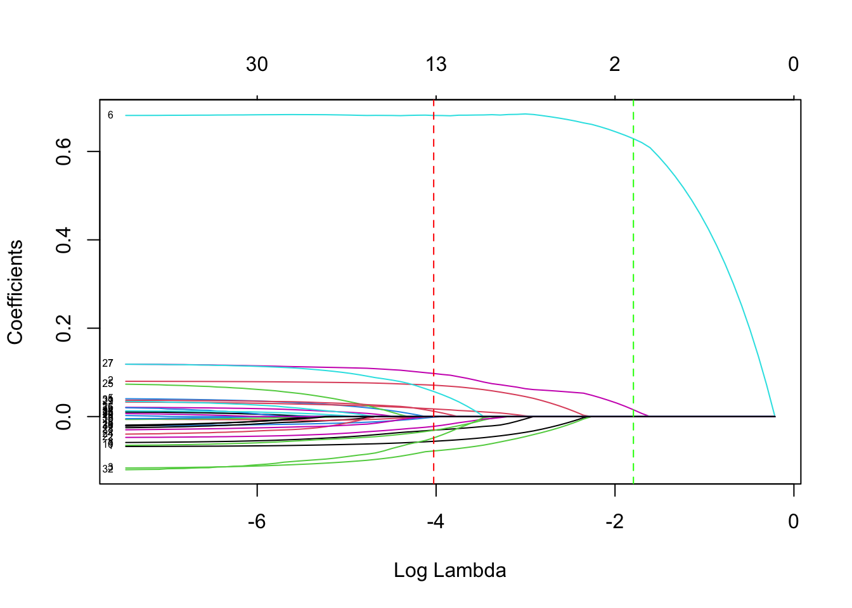
Lasso Regression – Selection of λ

Slide 54
Elastic Net Regression
Ridge regression tends to shrink the coefficients of correlated features toward each other.
Lasso will tend to pick one of the correlated features and ignore the others.
Elastic net attempts to leverage both of these feature by weighting the penalties in the objective functions.

Slide 55
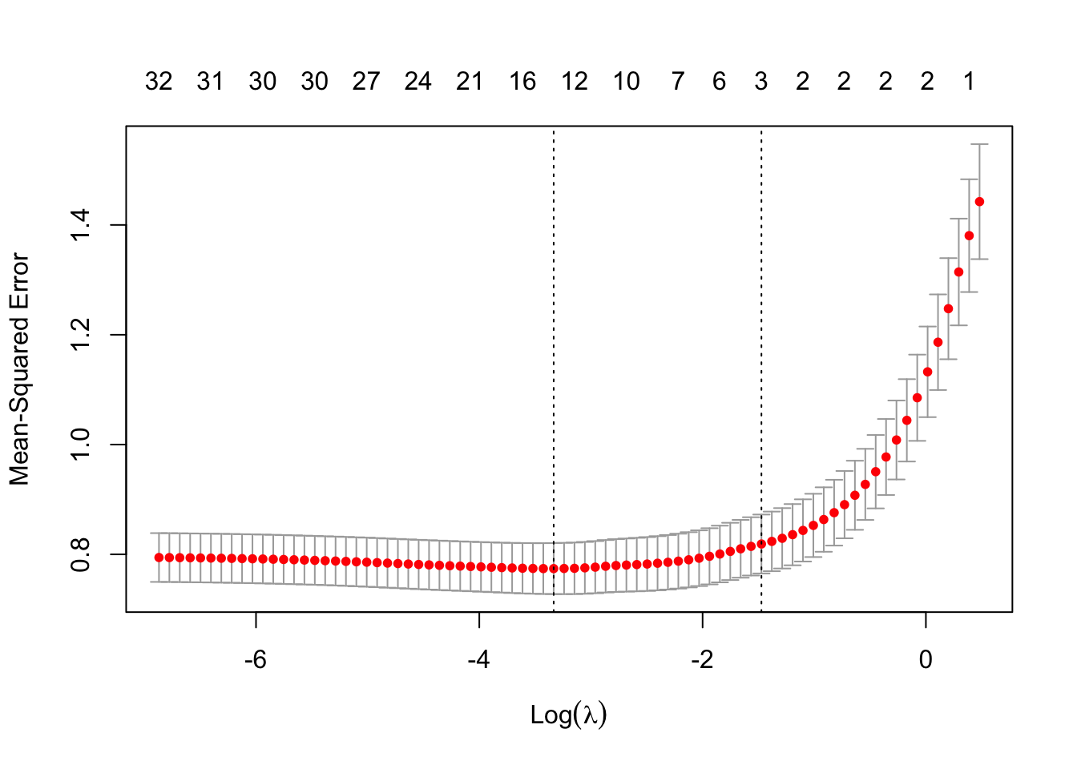
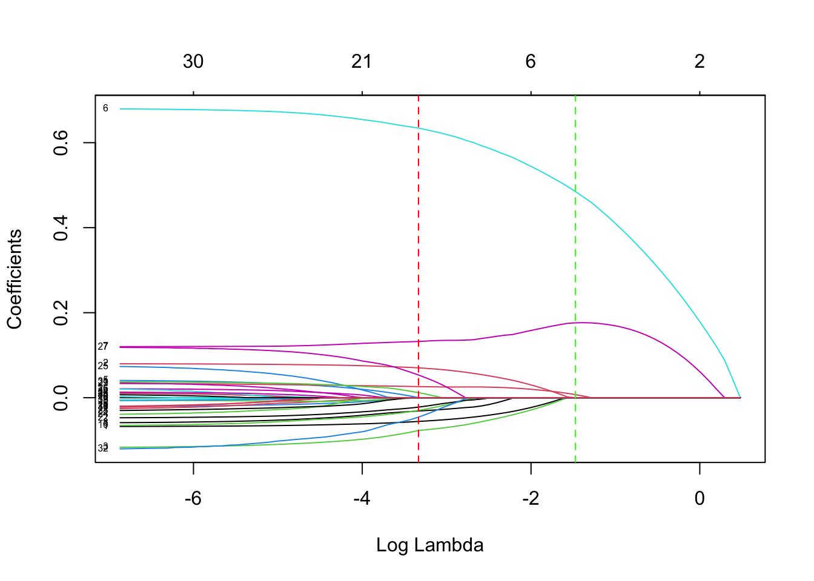
Elastic Net Regression Selection of λ

Slide 56
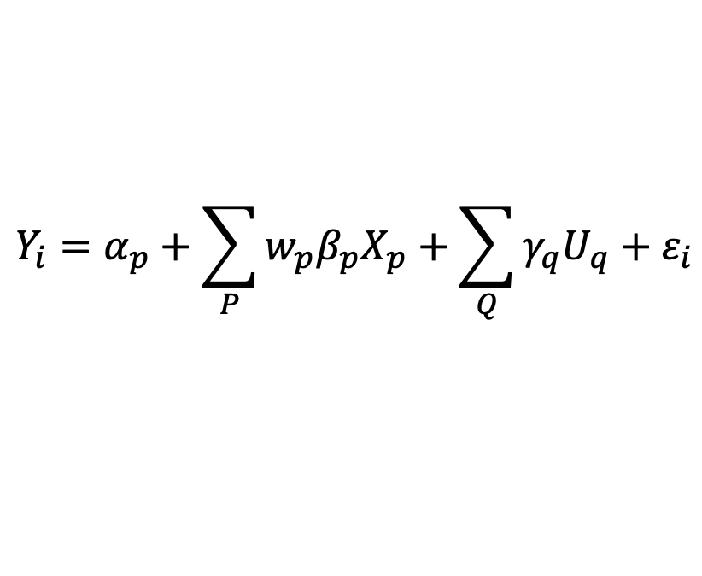
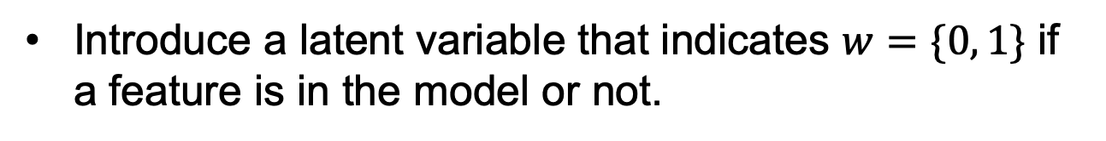
Bayesian Stochastic Selection
Introduce a latent variable that indicates $w=\{0, 1\}$ if a feature is in the model or not.
$$Y_{i}=α_{p}+\sum_{P}{w_{p}β_{p}X_{p}}+\sum_{Q}{γ_{q}U_{q}}+ε_{i}$$

Slide 57
Bayesian Stochastic Selection
Introduce a latent variable that indicates $w=\{0, 1\}$ if a feature is in the model or not.
$$Y_{i}=α_{p}+\sum_{P}{w_{p}β_{p}X_{p}}+\sum_{Q}{γ_{q}U_{q}}+ε_{i}$$
The prior on the effect estimates can be viewed as mixture of point mass at zero and a normal distribution.

Slide 58
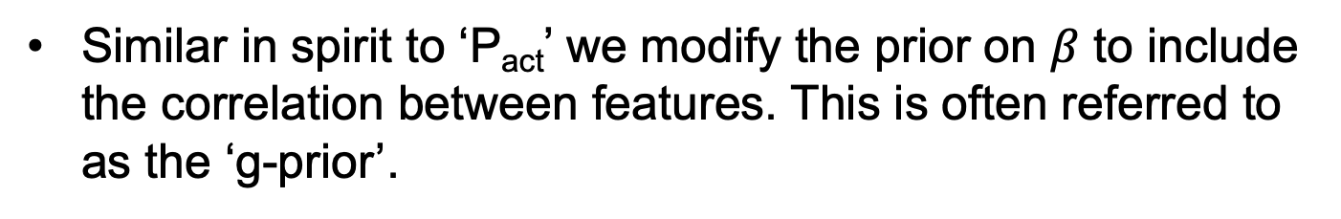
Bayesian Stochastic Selection
Similar in spirit to ‘P_{act}’ we modify the prior on $β$ to include the correlation between features. This is often referred to as the ‘g-prior’.

Slide 59
Bayesian Stochastic Selection
Similar in spirit to ‘P_{act}’ we modify the prior on $β$ to include the correlation between features. This is often referred to as the ‘g-prior’.
In linear regression this prior is conjugate and the posterior simplifies to:

Slide 60
Comparison of Approaches

Slide 61
Comparison of Approaches
Pro-inflammatory cytokines (IL-1 beta, IL-6, and TNF alpha) are responsible for early responses and amplify inflammatory reactions.
Leptin is at the interface between metabolism and inflammatory responses.
MCP1 recruits monocytes, memory T cells, and dendritic cells to the sites of inflammation produced by either tissue injury or infection.

Slide 62
Single Layer Omic Association
Y

Slide 63
Two-Layer Omic Data
Exposome (Organochlorines)
Proteome

Slide 64
Regression Across Many Correlated Variables
Exposome
Univariate model
Proteome

Slide 65
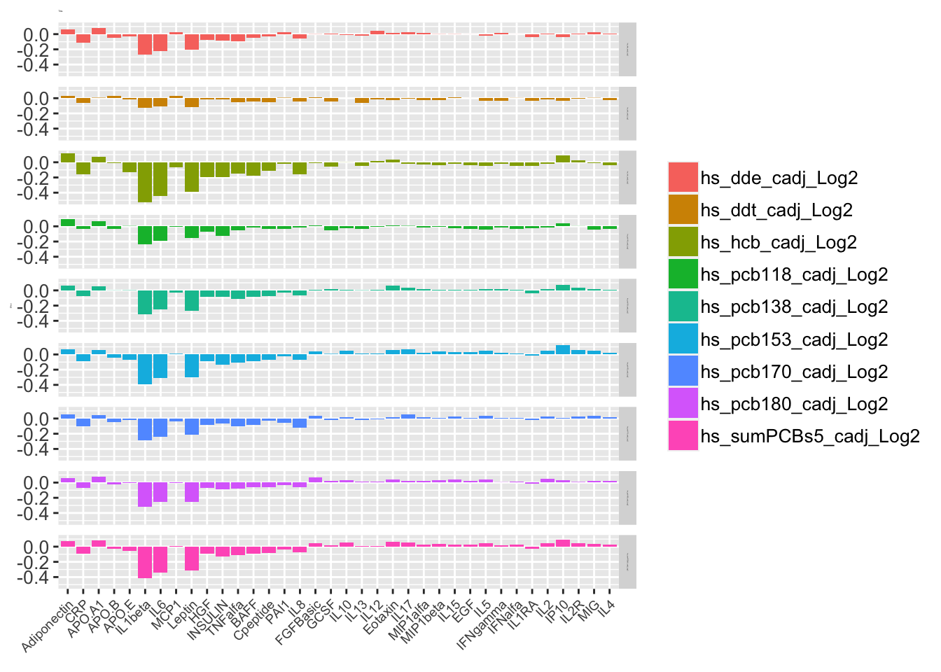
Interpreting Pairwise Results
Leveraging biology after analysis (i.e. use annotation):
Pathway-type analyses.

Slide 66
Interpreting Pairwise Results
Leveraging biology after analysis (i.e. use annotation):
Pathway-type analyses.
Pro-inflammatory cytokines (IL-1 beta, IL-6, and TNF alpha) are responsible for early responses and amplify inflammatory reactions.
Anti-inflammatory cytokines (IL-4, IL-10, and IL-13), limit the inflammatory reactions.

Slide 67
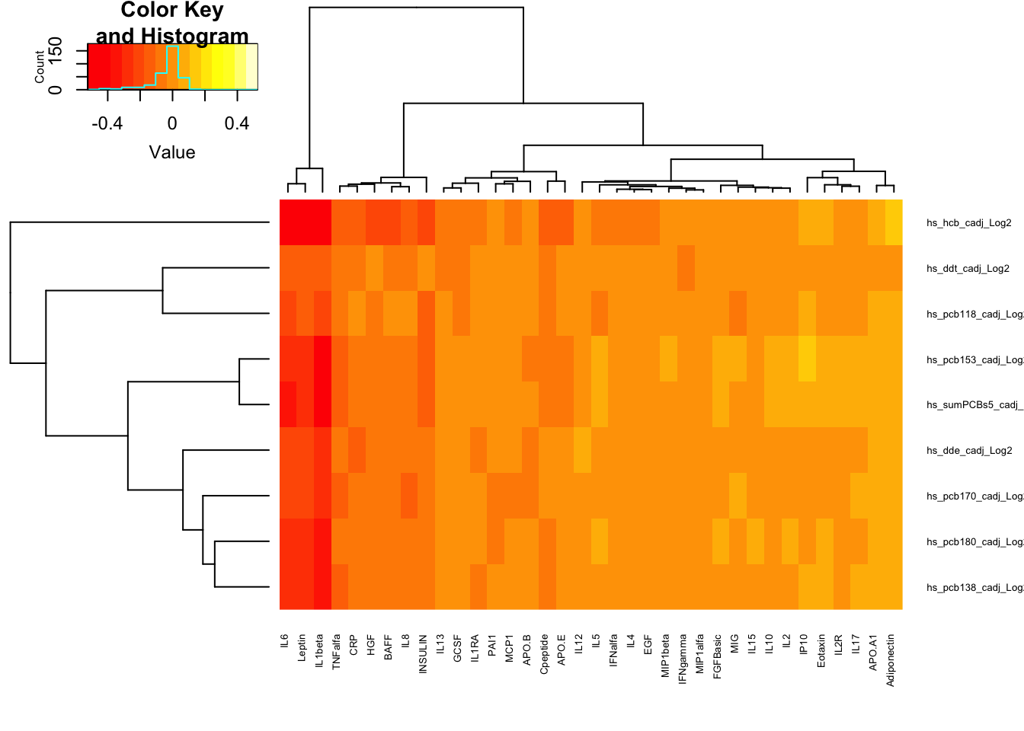
Interpreting Pairwise Results
Data driven after analysis:

Slide 68
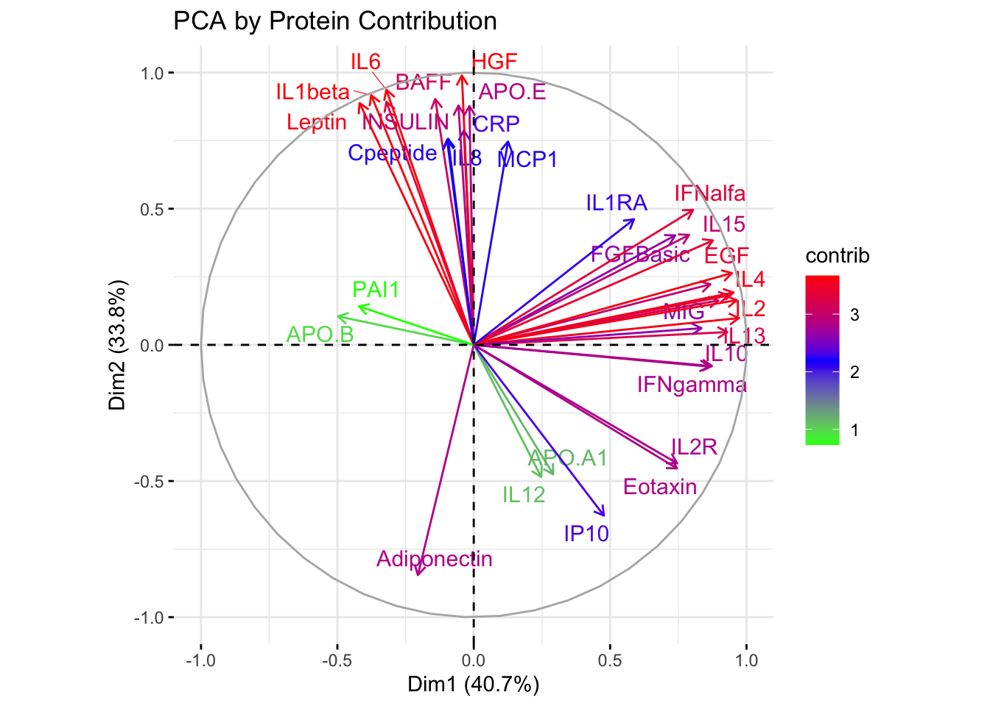
Interpreting Pairwise Results

Slide 69
Multi-omics Without an Outcome
Association-Integration: Perform pairwise association analyses, then integrate with interpretation.
Association for Integration and then Interpretation
(Biology or Data Driven)

Slide 70
Multi-omics Without an Outcome
Late-Integration: Perform clustering/dimension reduction within each omic layer, then integrate with association analysis and interpretation.
?
L₁
L₂
Late-Omic Integration
(Association)
Rappoport and Shamir. Nucleic Acids Research 2018

Slide 71
Multi-omics without Outcome
Early-Integration: Concatenate multiple omic layers and perform clustering/dimension reduction. Interpret results.
Early-Integration
L₁
Interpretation of Results
(Biology)
Rappoport and Shamir. Nucleic Acids Research 2018

Slide 72
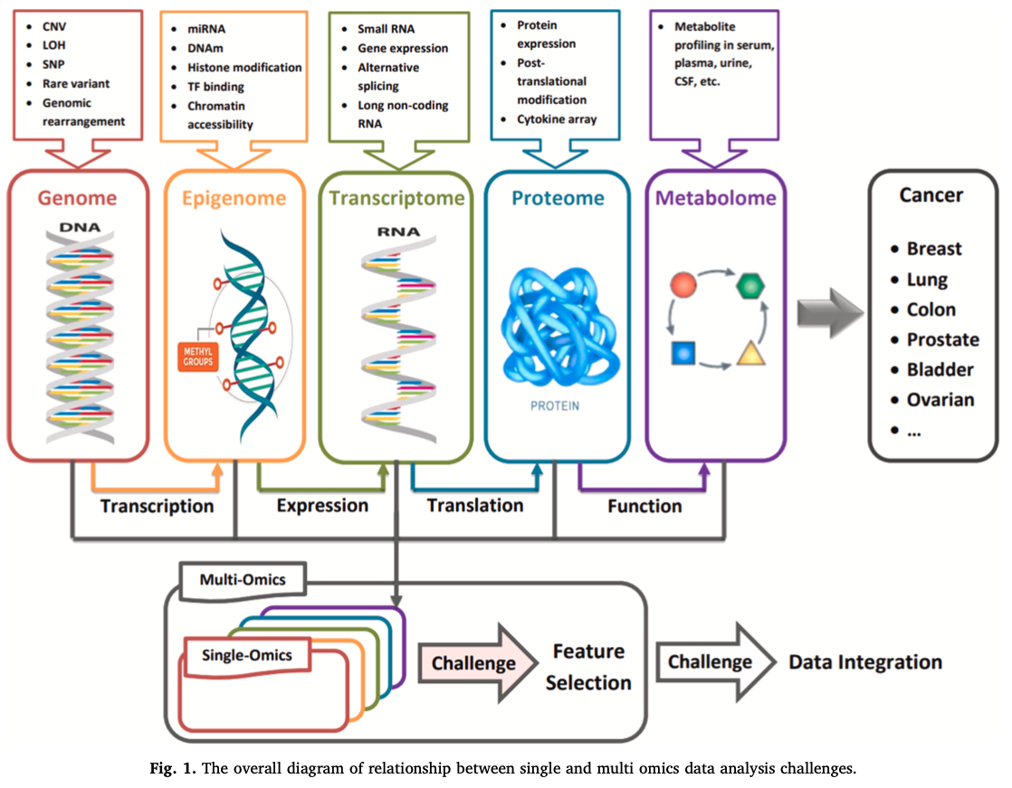
Multi-omics with an Outcome

Slide 73
Multi-omics Association Analysis With an Outcome

Slide 74
Multi-omics Association Analysis With an Outcome
Early-Integration: Concatenate multiple omic layers and perform clustering/dimension reduction. Then perform association to the outcome.
Early-Integration
?
L₁
Y

Slide 75
Multi-omics Without an Outcome
Late-Integration: Perform clustering/dimension reduction within each omic layer, then integrate with association analysis and interpretation.
?
L₁
L₂

Slide 76
Multi-omics Association Analysis With an Outcome
Late-Integration: Perform clustering/dimension reduction within each omic layer, then integrate with association analysis to the outcome and interpret.
L₁
L₂
Y

Slide 77
Multi-omics Without an Outcome
Association-Integration: Perform pairwise association analyses, then integrate with interpretation.
Association for Integration and then Interpretation
(Biology or Data Driven)

Slide 78
Multi-omics Association Analysis With an Outcome
Where and when to perform association?
Y

Slide 79
High Dimensional Interactions
E
Y
G
E
E
E
E

Slide 80
High Dimensional Interactions
E
E
E
E
Y
G
E
E
E
E

Slide 81
High Dimensional Interactions
L_{E}
Y
L_{G}

Slide 82
Using SNPs as Instrumental Variables
Omic
G
Y
E
E
E
E
82

Slide 83
Using SNPs as Instrumental Variables
L_{E}
G
Y
E
E
E
E
83

Slide 84
High Dimensional Mediation
Omic
G/E
Y
84

Slide 85
Latent Mediation
L_{E}
G/E
Y
85

Slide 86
Mediation With Multiple Exposures
Omic
G/E
Y
E
E
E
E
86

Slide 87
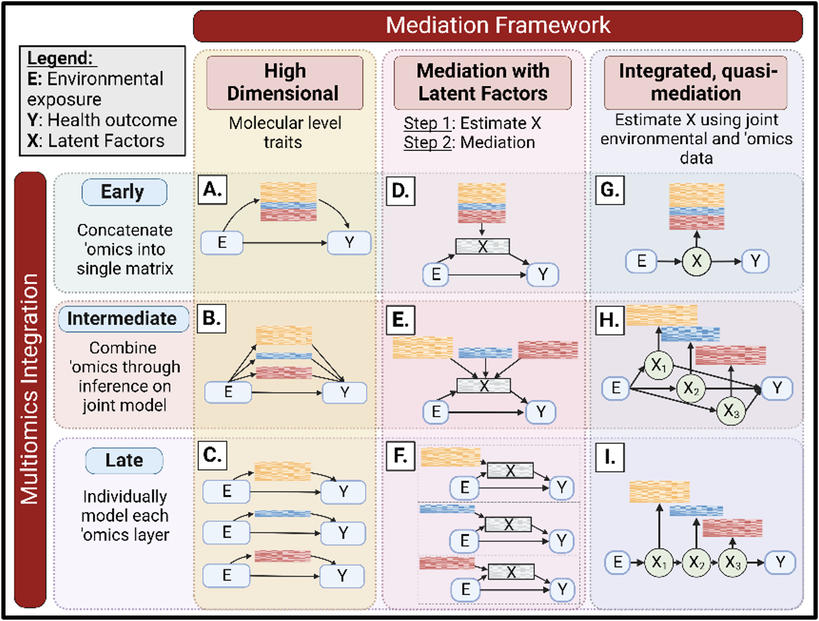
Multi-omics Integrated Analysis
87

Slide 88

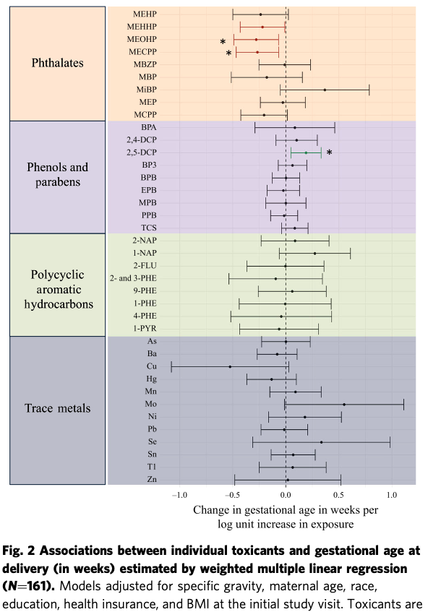
Exposome
Y
88

Slide 89
Biomarkers
Omic
Exposome
Gestational Age
E
Y
E
E
E
E
89

Slide 90
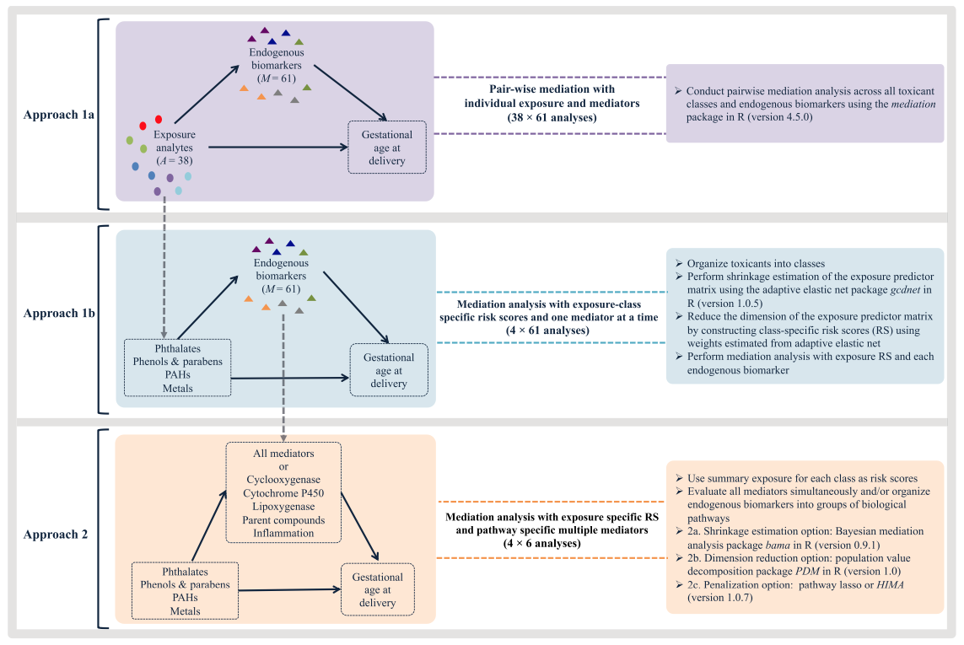
90

Slide 91
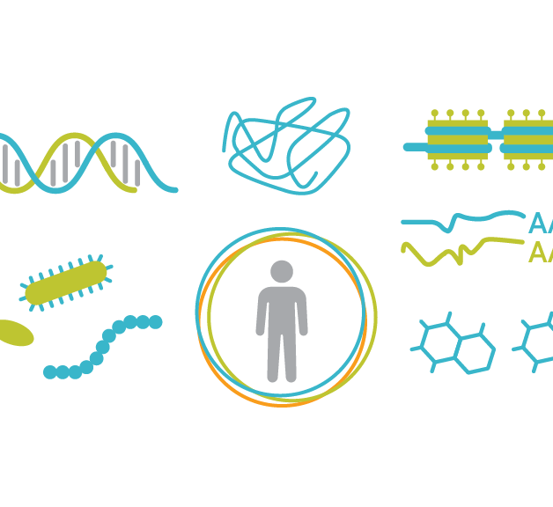
Day 1: June 12, 2024
9:00 - 9:45 PT
10:00 - 11:00 PT
11:15 - 12:30 PT
12:30 - 1:30 PT
1:30 - 2:15 PT
2:30 - 3:00 PT
3:00 - 3:15 PT
Welcome and Introduction
Introduction to Observational Studies and Omic Data
Polygenic Analyses and Summary Statistics (Lecture)
Meal Break (Instructors will be available 12:30-12:55 PT)
Polygenic Analyses and Summary Statistics (Lab)
Advanced Polygenic analysis and Summary Statistics (Lab 2)
Questions and Day 1 Wrap-up

